Slide 1
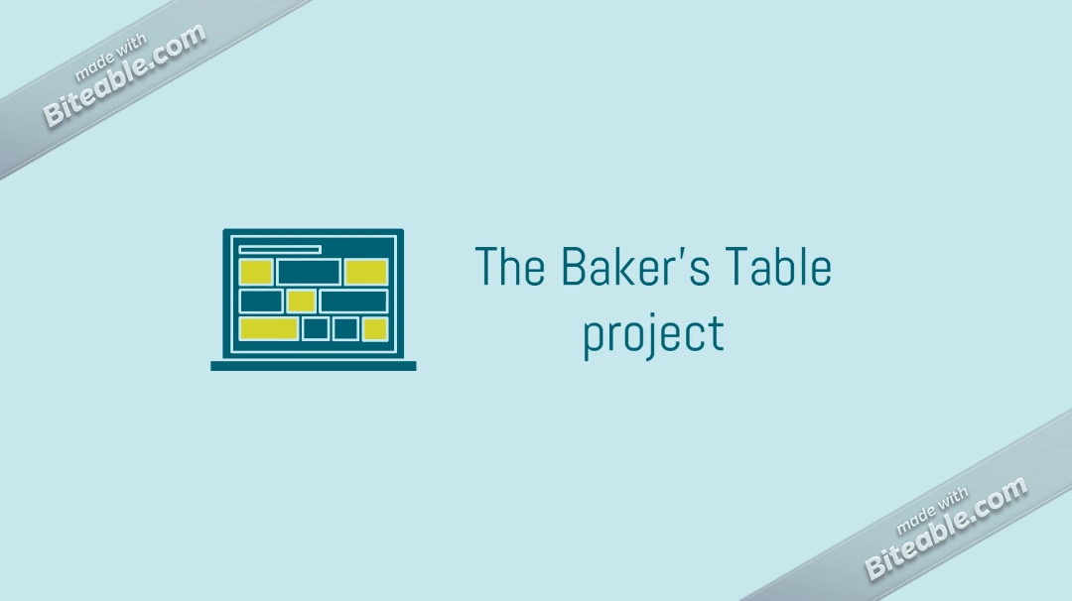
##YOUR OWN STORY

Slide 2
What is “THE BAKER’S TABLE” ??
The competitive world along with digitalization and covid -19 has made it hard for new budding businesses to set a foot in the market.
The “BAKER’S TABLE” is typically a web app which would be designed for budding businesses who are trying to set their foot in the market and eventually expand it, by providing them with facility to have one to one interaction with their customers.

Slide 3
CONCEPT BEHIND THIS PROJECT!!
Many small and new businesses these days face a lot of problems to expand their businesses .We intend to provide them a platform to expand it and where the owner and customer have one to one interaction .
We at the same time intend to maintain the authenticity and originality of the businesses .

Slide 4
->Establishing A Local for vocal solution for enriching the small local shops to gain one to one owner, customer experience through a single platform.
->Our Solution To The business problem will include a web application based prototype.
->There’ll be personalized delivery from your Bakery.
->Instant push notification for client and customer.
->Feedback and review rating option.
->Multiple Payment options.

Slide 5
INDUSTRY IMPACT
Establishing A Local for vocal solution for enriching the small local shops to gain one to one owner, customer experience through a single platform.
The pandemic has really affected the small shop owners in many ways and therefore to help them regain their business and get it back on the track.
Also it will increase clientele of the business by improving their communication with customers and help them with task such as delivery.

Slide 6
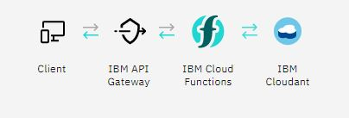
TECHNOLOGIES USED..
The technology stack to be used for web application will include
Angular for front end Development
My SQL for database management and
Node Js for backend management.

Slide 7
IBM SERVICES WE USED …
IBM® Db2® Warehouse on Cloud is a fully managed, elastic cloud data warehouse that delivers independent scaling of storage and compute.
IBM Cloud® offers purpose-built databases that deliver high availability, enhanced security and scalable performance. ... DBaaS solutions on IBM Cloud include auto provisioning, hosting, and 24x7 management with automated high availability, backup and restore, version upgrades, security and more.
Serverless Backends
Expose application logic by implementing serverless microservices. Simply map your functions to well-defined API endpoints any client can call by making use of Web Actions or our latest API Gateway integration.
Users may build their own private cloud or purchase services hosted on the IBM cloud. Users may also purchase IBM hardware, software and services to build their customized cloud environment.

Slide 8
Watson Assistant/Watson Natural Language Understanding
Provide customers with fast, consistent and accurate answers across any application, device or channel.
Increase understanding of human language by analyzing text and identifying concepts, keywords, categories, sentiment, and more.
IBM Cloud container
Containers are a form of operating system virtualization. A single container might be used to run anything from a small microservice or software process to a larger application. Inside a container are all the necessary executables, binary code, libraries, and configuration files.
Containers are packages of software that contain all of the necessary elements to run in any environment. In this way, containers virtualize the operating system and run anywhere, from a private data center to the public cloud or even on a developer's personal laptop.

Slide 9
EXTENT OF IMPLEMENTATION
This web app right now solely focuses on small and new bakery shops
We aim to develop our web app for more than just bakeries such as handcraft shops ,gyms and as We believe in maintaining the authenticity and originality and are bound to be credible to our customers .we would ensure that our services do not lack.

Slide 10
THE X-FACTOR OF OUR PRODUCT !!!
We will customize the web app, taking it from a functional state to a production-ready state. This will involve finding and handling error cases, adding accessibility features, allowing for localization, mediator free service etc.
There’ll be vouchers and coupons for repetitive customers as well as first time customers.
Customer and owner will have their own encrypted accounts and encrypted payment linking options cause privacy and security are a must.
Multiple Payment options.

Slide 11
Aim to Customize / personalize your order.
Hyperlink and enrich username to make business grow and add hash tags in your bio.

Slide 12
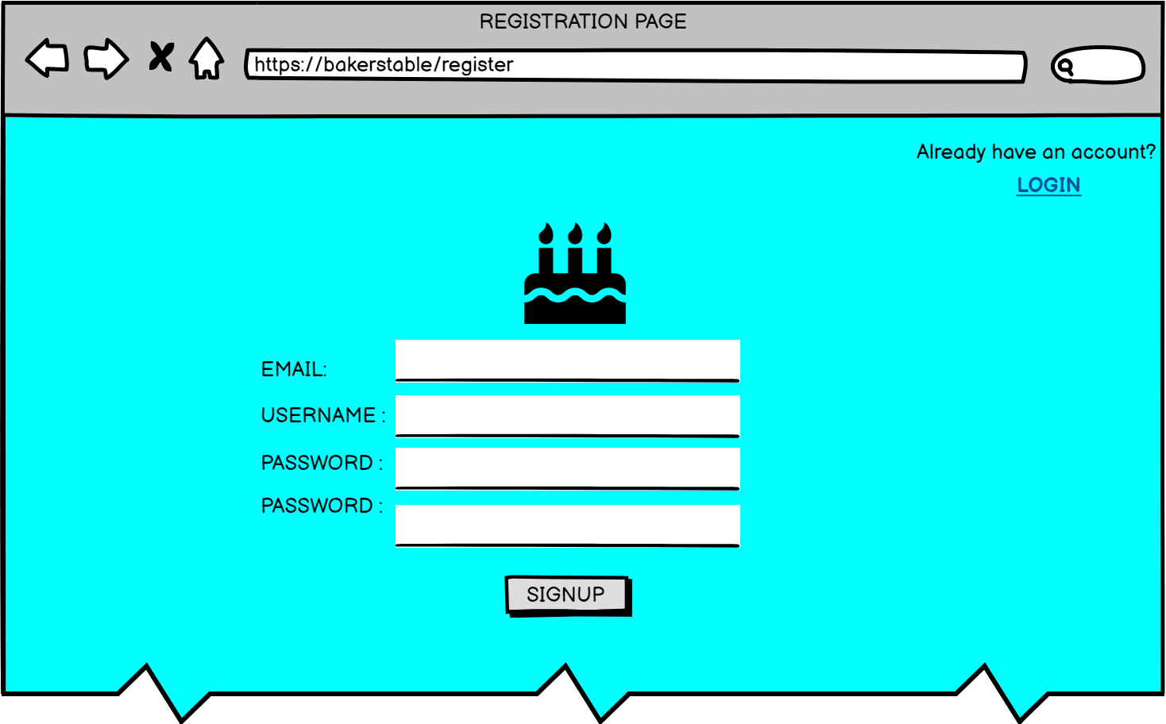
Wire-Frame Diagrams

Slide 13
